Slide 1
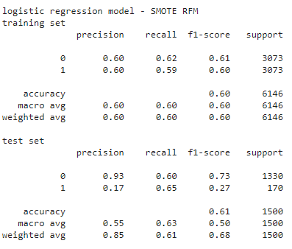
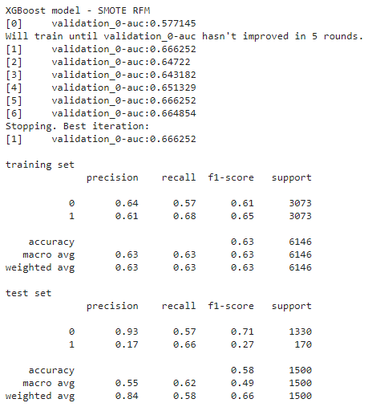
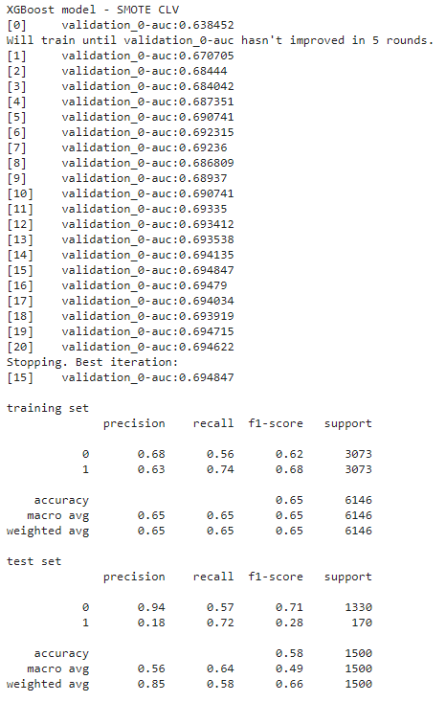
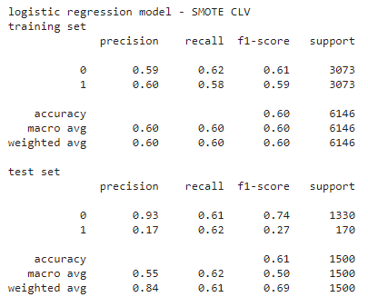
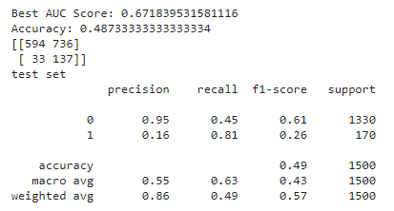
Results from Original File
Logistic Regression with SMOTE
XGBoost with SMOTE
What to do
Drop March 2013 - March 2015
Fix imbalanced data with undersampling and oversampling
Calculate AUC
Compare !
Let’s start…
Tuning CLV

Slide 2
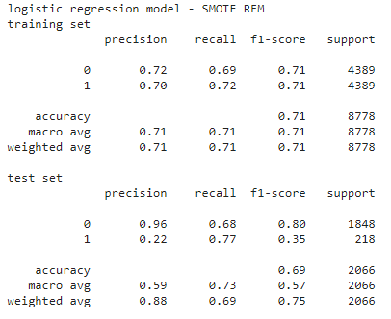
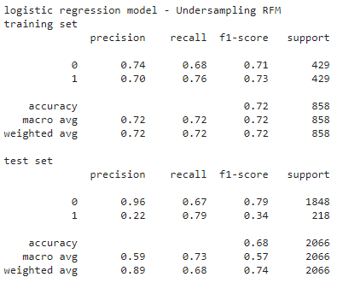
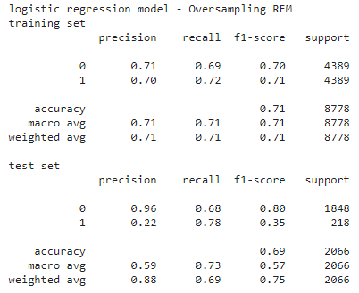
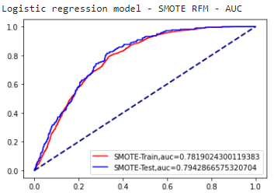
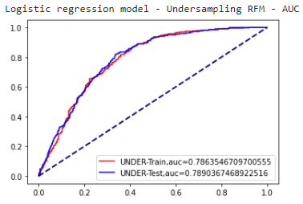
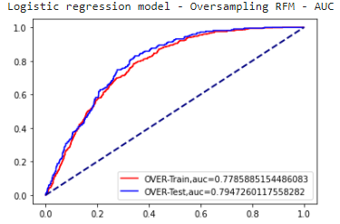
Results from My File
Logistic Regression SMOTE - RFM
Logistic Regression Undersampling - RFM
Logistic Regression Oversampling - RFM

Slide 3
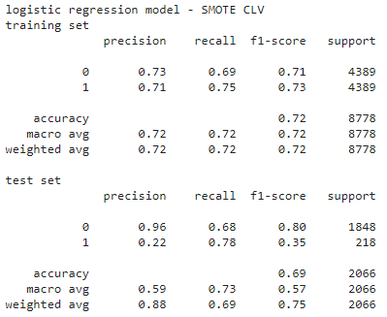
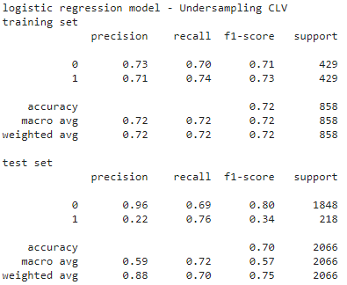
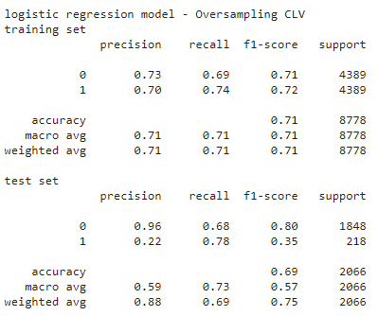
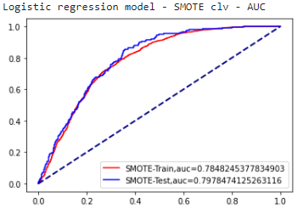

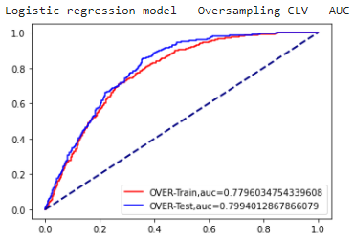
Results from My File
Logistic Regression SMOTE - CLV
Logistic Regression Undersampling - CLV
Logistic Regression Oversampling - CLV

Slide 4
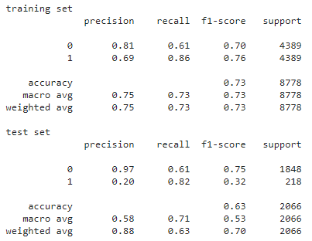
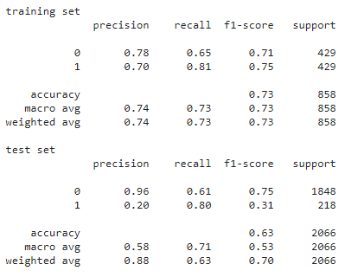
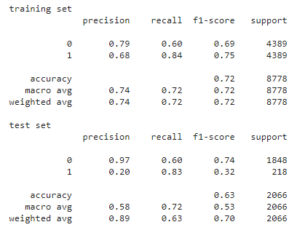
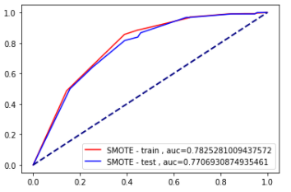
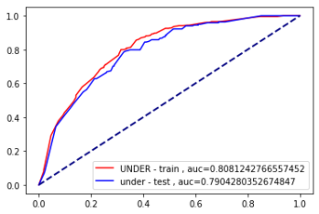
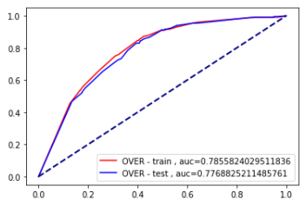
Results from My File
XGBoost SMOTE - RFM
XGBoost Undersampling - RFM
XGBoost Oversampling - RFM

Slide 5
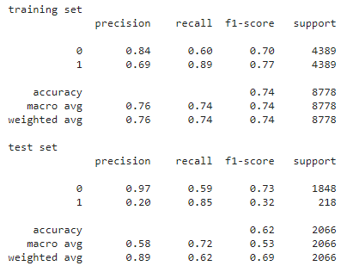
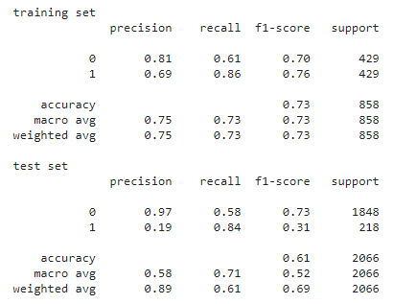
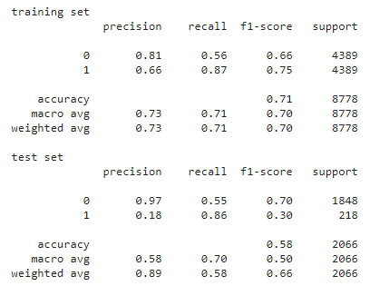
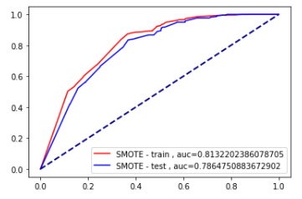
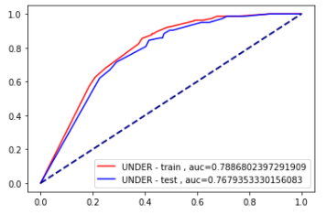
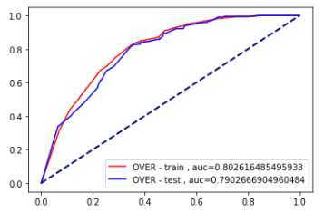
Results from My File
Logistic Regression SMOTE - CLV
Logistic Regression Undersampling - CLV
Logistic Regression Oversampling - CLV

Slide 6
Results from My File
Logistic Regression SMOTE - CLV
Logistic Regression Undersampling - CLV
Logistic Regression Oversampling - CLV

Slide 7
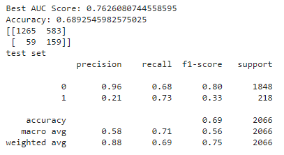
Results from My File
Tuning - RFM
Summary
Dropped the timeframe before 2013-03-01 provided the better results so, we could imply that the effectiveness of models depended on appropriate timeframe.
Evaluated with by ‘accuracy’ was not enough, calculated ROC curve would be a good choice to figure out the exact best result.
Based on The accuracy and AUC Score, the best model was presented by Logistic Regression Oversampling – CLV
at Accuracy = 0.69 (better than original model at 0.61)
at AUC = 0.799 (0.666)
The result wasn’t better than other models
So, I decided not to do other steps.

